Slide 1
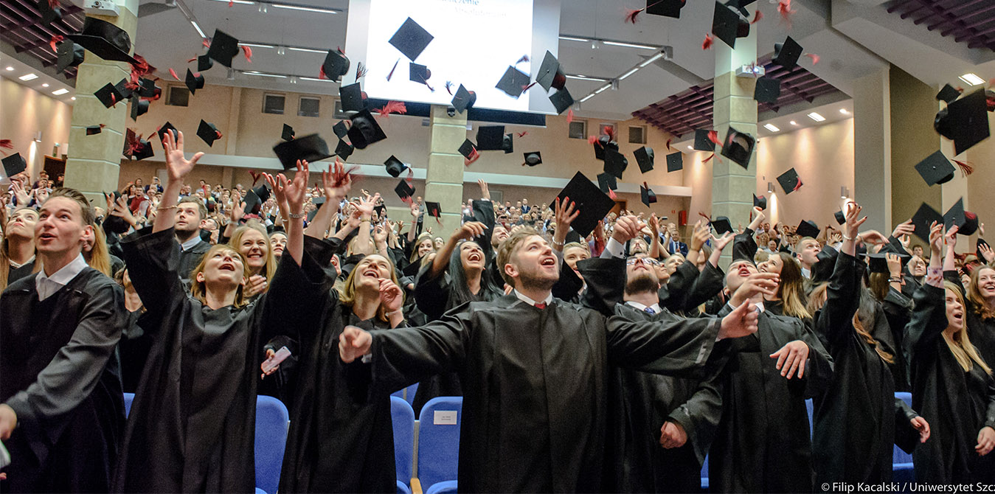


Doctoral School the University of great, countless opportunities

Slide 2
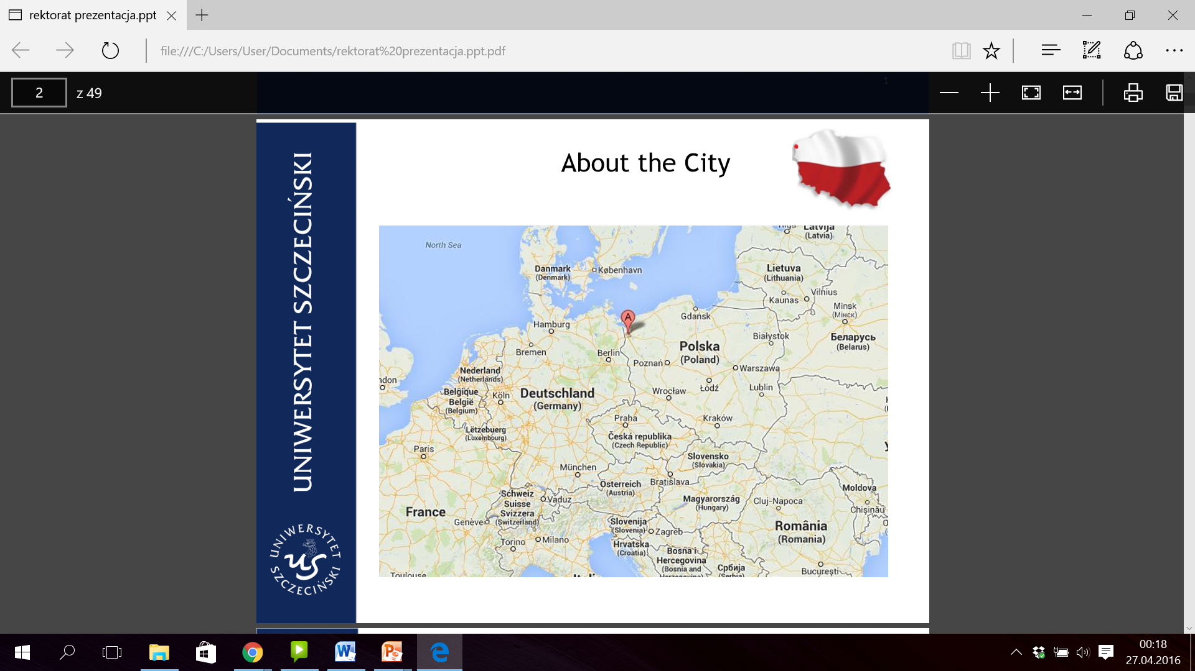

The City

Slide 3
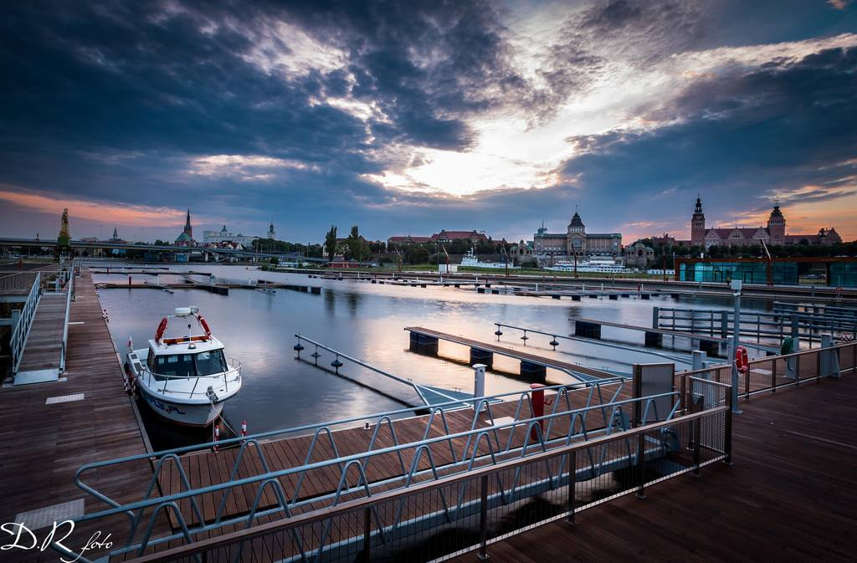
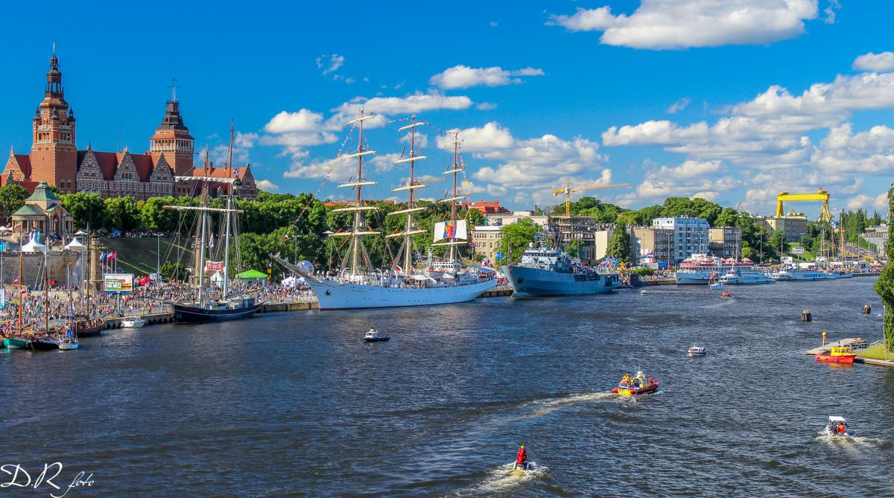

Szczecin, the capital of the West Pomerania region;
One of the biggest cities in Poland;
Population of nearly 400 000 people;
Green city has a total of more than 500 hectares of urban green areas including 15 parks, 90 lawns.

Slide 4
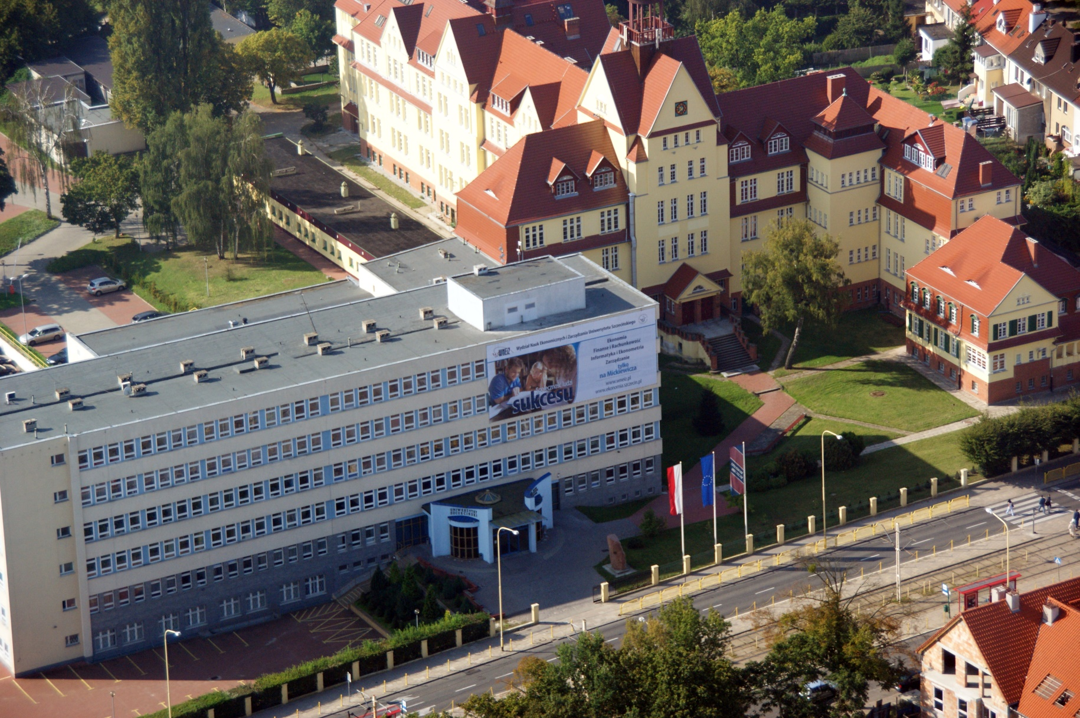
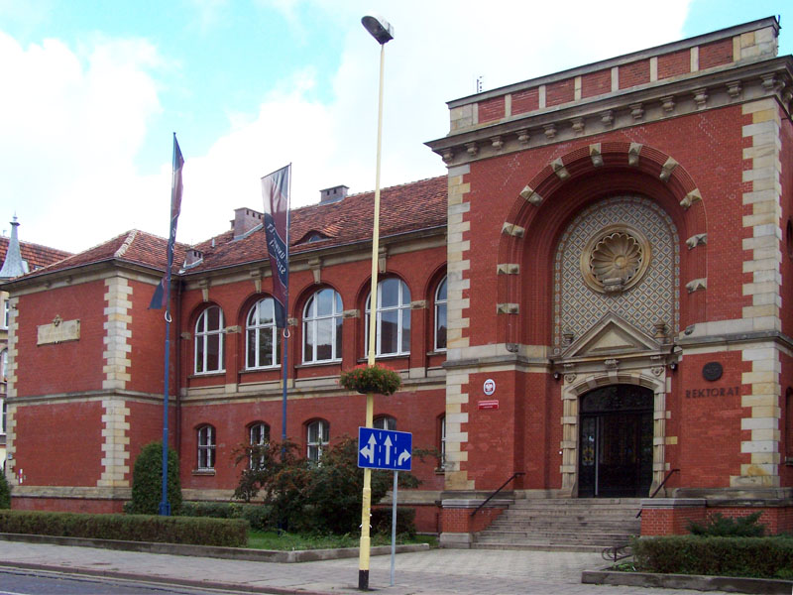
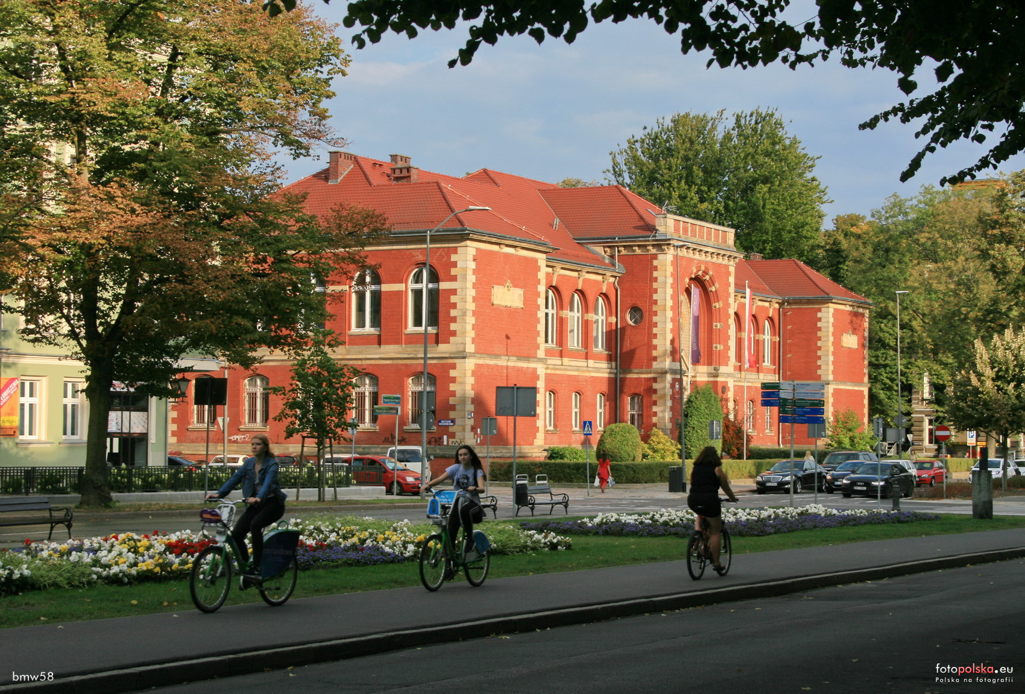
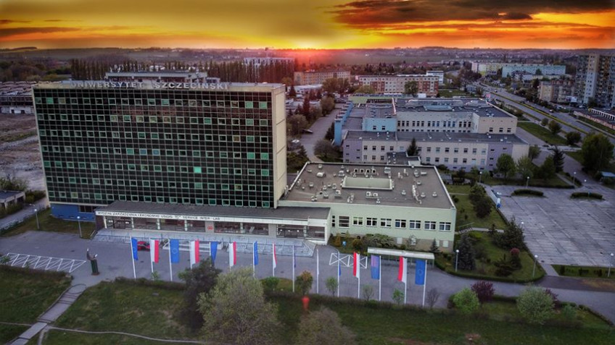

Slide 5
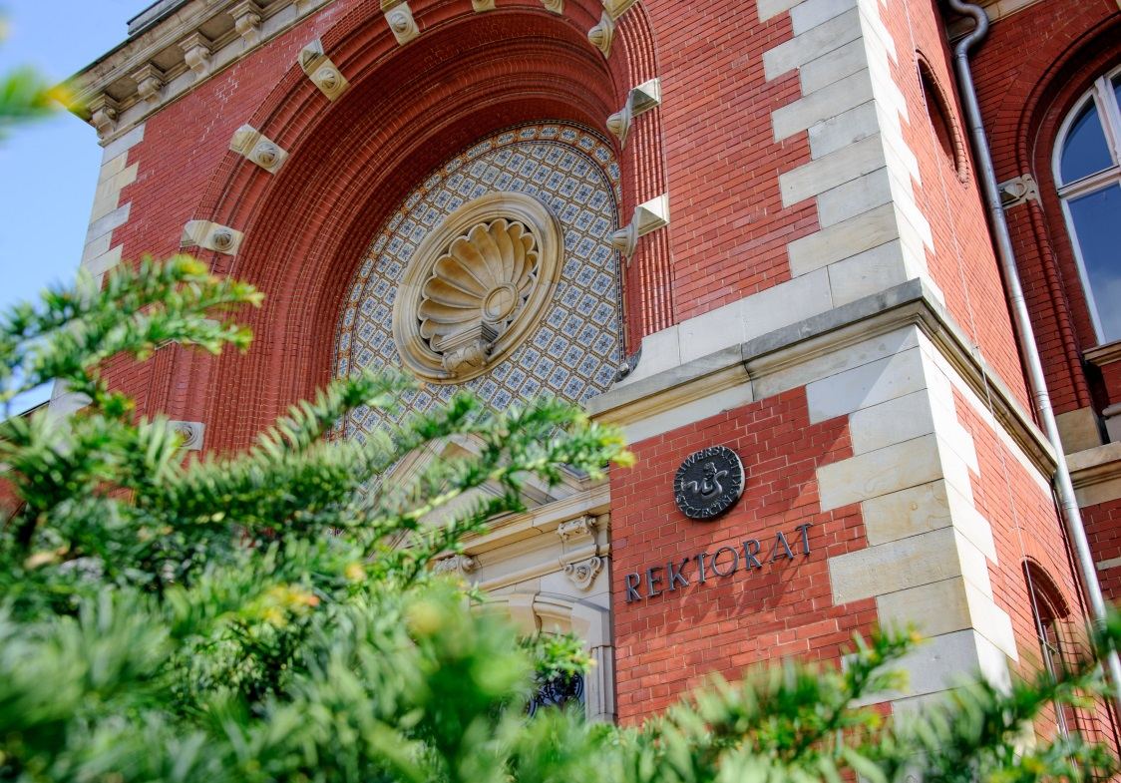
University
The University of Szczecin was founded 40 years ago;
The largest university in the West Pomerania region;
Nearly 12 thousand students;
Approximately 80 fields of study;
160 student research groups, choir, sports teams, theatre, and music groups;
Career planning assistance.

Slide 6
Faculty of Economics, Finance, Management
We are the oldest Faculty in West Pomerian Region (1946 – Faculty was established);
We are the best ! (It is ranked 9th among 92 Polish centers educating in economics);
We have three full programms in English;
We have a PhD programm in English.

Slide 7
Offer for students:
Economics and IT applications (Bachelor) International Economics (Master)
education of professionals, whose responsibilities will include ability to manage, control and monitor activities of company or other organization as well as the identification and selection of appropriate computer tools;
Business management (Bachelor and Master)
practical knowledge in the field of management sciences and related sciences dealing with the substance, principles and problems concerning the functioning of the entities from the business, public, social and non-profit sector;
More information at: http://en.foreigners.usz.edu.pl/

Slide 8
PhD opportunities in Doctoral School:
philosophy,
history,
linguistics,
literary studies,
pedagogy,
political and administrative sciences,
physics,
mathematics,
economics and finance,
psychology,
management and quality sciences,
biology,
legal sciences,
theology,
sociological sciences,
physical culture sciences,
earth and environmental sciences,
socio-economic geography and spatial management.

Slide 9
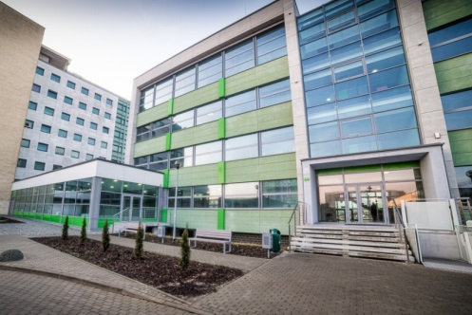
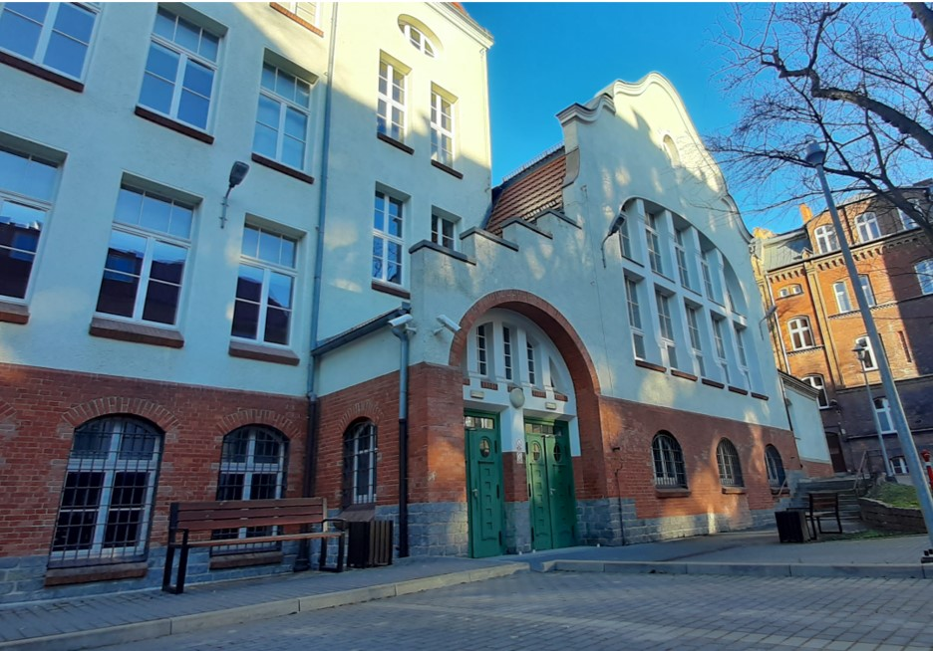
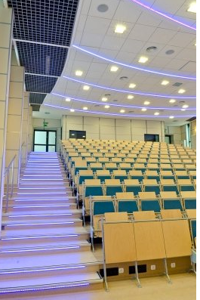
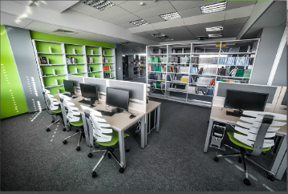

Slide 10
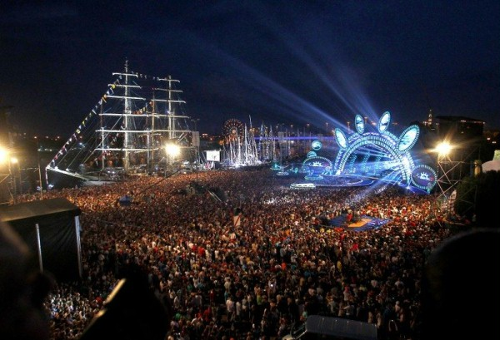
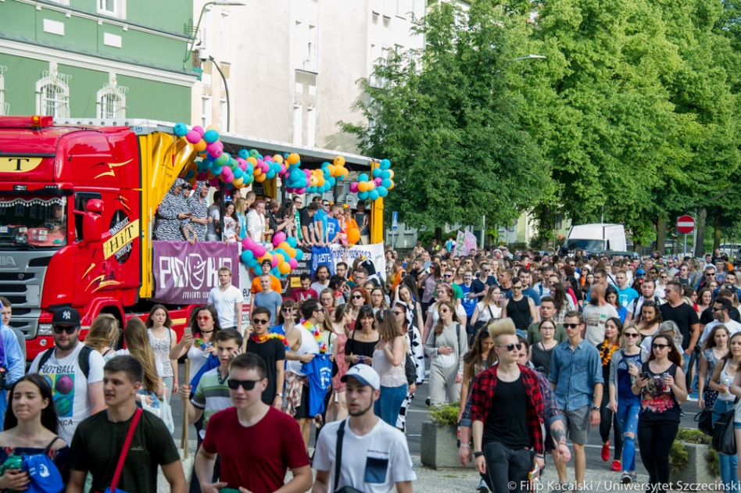



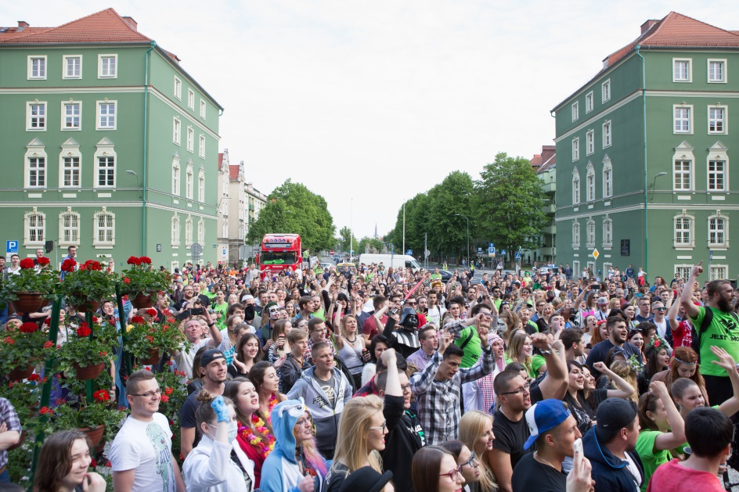
Cultural activities

Slide 11
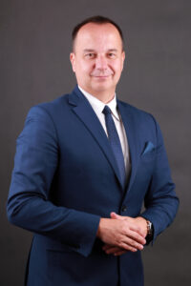
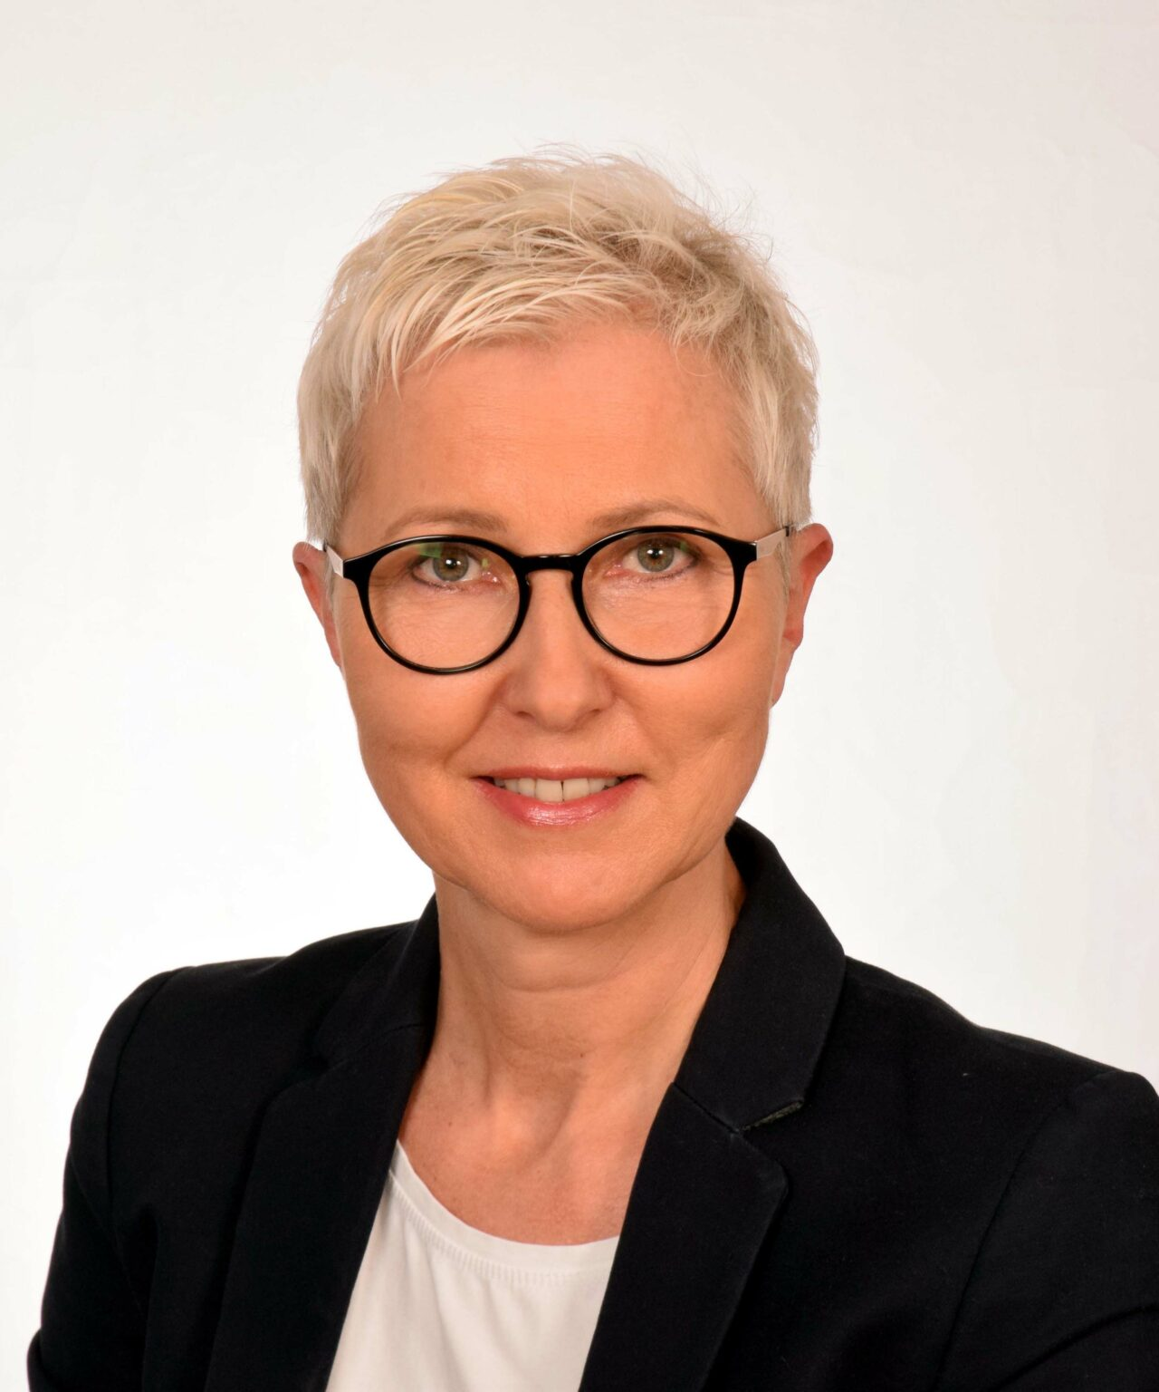
THE MANAGEMENT OF THE DOCTORAL SCHOOL
DIRECTOR OF THE DOCTORAL SCHOOL
Jarosław Korpysa, PhD, Accoc. Prof.
jaroslaw.korpysa@usz.edu.pl
DEPUTY DIRECTOR OF THE DOCTORAL SCHOOL
Katarzyna Leźnicka, PhD, Accoc. Prof.
katarzyna.leznicka@usz.edu.pl

Slide 12
THE OFFICE OF THE DOCTORAL SCHOOL
mgr Katarzyna Tokarska (The Head of the Office)
mgr Irena Baranowska (grants)
mgr Agnieszka Pszonak (education support)
mgr Marta Martenka-Pasieka (a person dedicated to the English-speaking students)
mgr Anna Barnaś (a person dedicated to the English-speaking students)
mgr Izabela Sawczuk (a person dedicated to the English-speaking students)
Alicja Szymczykiewicz (a person dedicated to the English-speaking students)

Slide 13
SCIENTIFIC BOARD OF THE DOCTORAL SCHOOL
prof. Iga Rudawska (social sciences) – The Chairwoman of the Scientific Board;
prof. Renata Ziemińska (humanities);
prof. Piotr Krupiński (humanities);
prof. Marek Sawczuk (physical culture science);
prof. Paweł Terefeko (natural sciences);
prof. Maciej Kowalewski (social sciences);
prof. Kesra Nermend (social sciences);
mgr Grzegorz Sadłowski (PhD student representative).

Slide 14
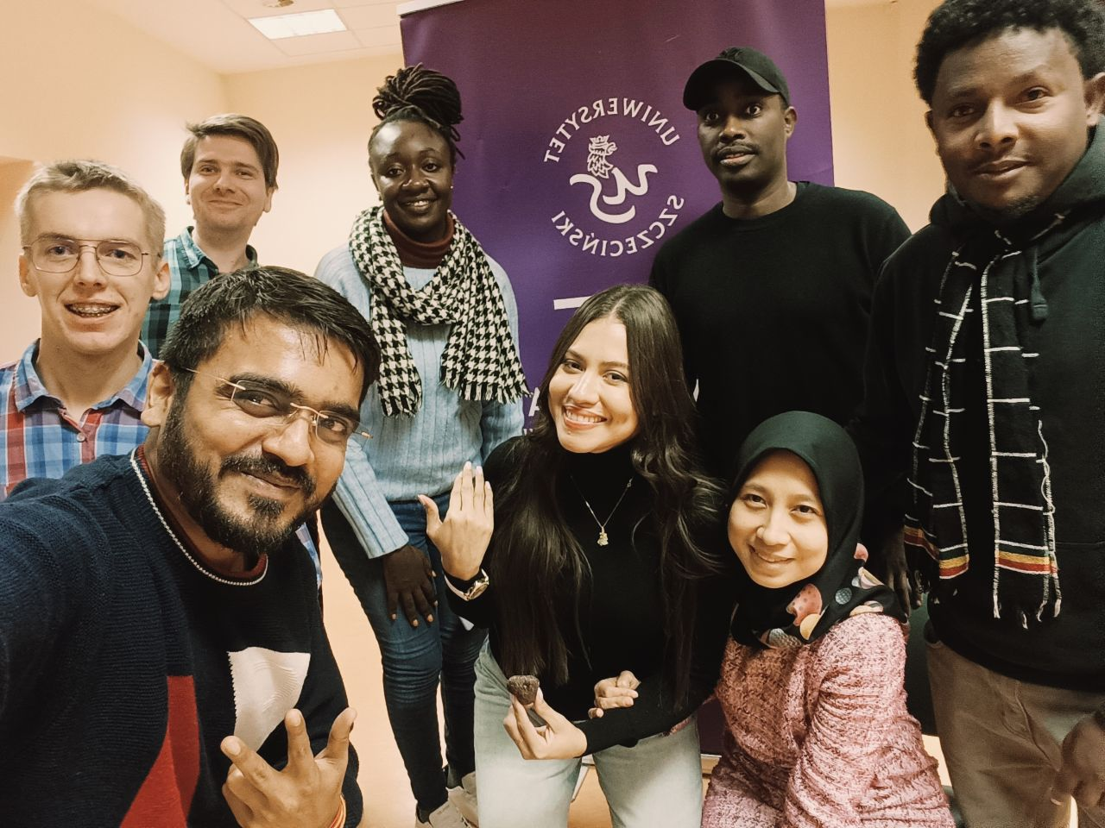
STUDYING
8 semesters (40 ECTS)
494 h, including:
214 h lectures;
120 h seminars;
60 h didactic practise;
80 h individual module.

Slide 15
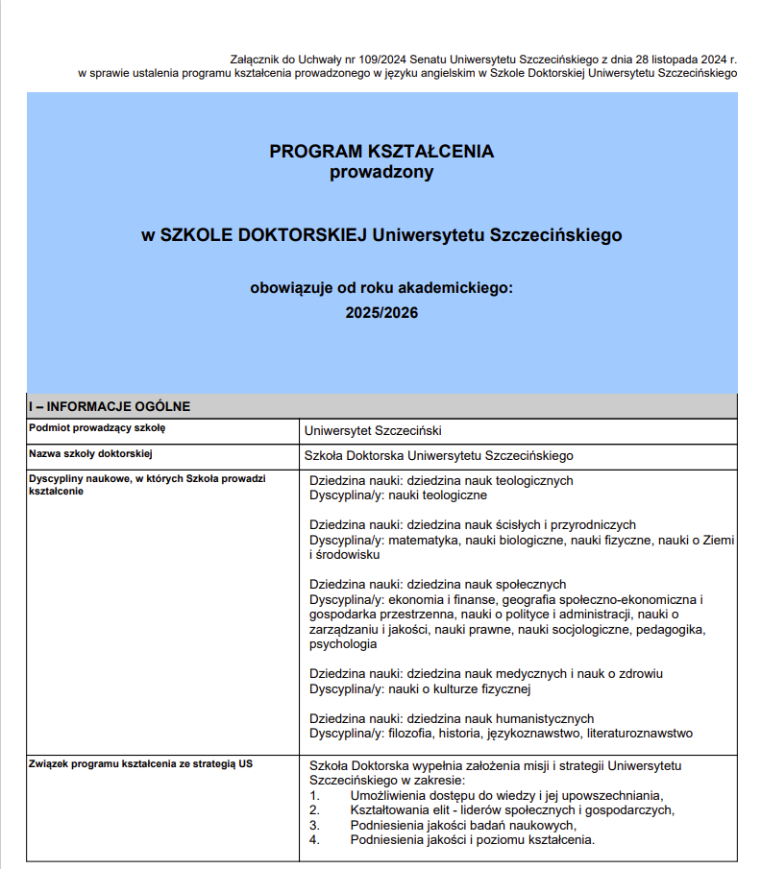
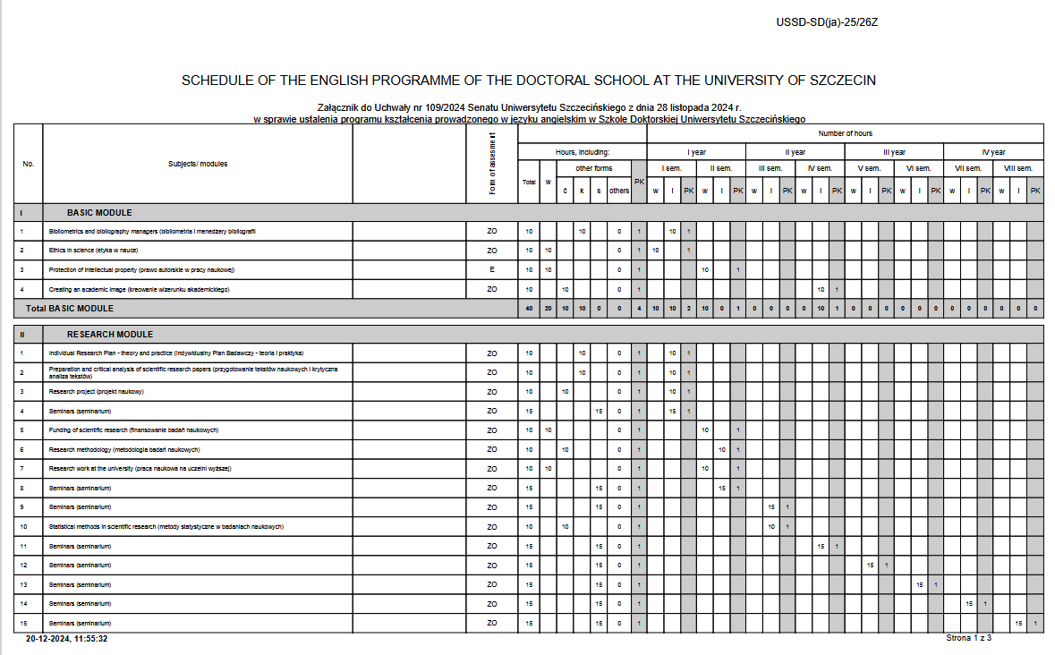
Curriculum-in-English

Slide 16
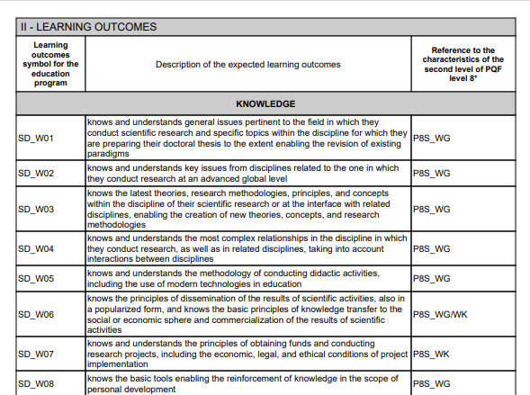
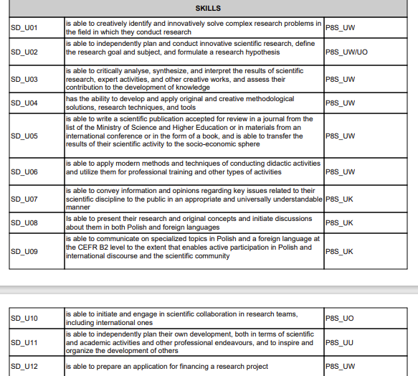
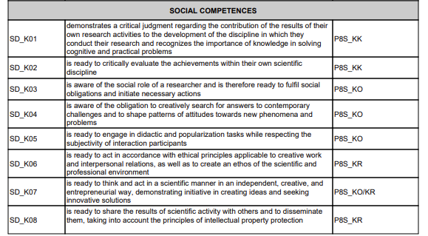

Slide 17
Studying:
Modules:
Basic module 40 h, 4 ECTS
Research module 190 h, 15 ECTS
Teaching module 40 h, 4 ECTS
Competences module 35 h, 3 ECTS
Individual module 80 h, 12 ECTS
Didactic practise 60 h, 2 ECTS
In individual module classes may be chosen among optional activities.

Slide 18
BASIC MODULE
OBLIGATORY:
Bibliometrics and bibliography managers 10 h, 1 ECTS
Ethics in science 10 h, 1 ECTS
Protection of intellectual property 10 h, 1 ECTS
Creating an academic image 10 h, 1 ECTS
Total 40 h, 4 ECTS

Slide 19
RESEARCH MODULE
OBLIGATORY:
Individual research plan 10 h, 1 ECTS
Research project 10 h, 1 ECTS
Preparation and critical analysis of scientific research papers 15 h, 2 ECTS
Seminars (15h/semester) 120 h, 8 ECTS
Statistical methods in scientific research 10 h, 1 ECTS
Funding of scientific research 10 h, 1 ECTS
Research methodology 10 h, 1 ECTS
Research work at the university 10 h, 1 ECTS
Total 190 h, 15 ECTS

Slide 20
TEACHING MODULE
OBLIGATORY:
Teaching design and planning: EQF and PRK 10 h, 1 ECTS
Digital media in academic education 10 h, 1 ECTS
The role of tutoring in teaching proces 10 h, 1 ECTS
Working with people with special needs 10 h, 1 ECTS
Total 40 h, 4 ECTS

Slide 21
COMPETENCES MODULE
OBLIGATORY:
Public speaking with voice care 15 h, 1 ECTS
Assertivness 10 h, 1 ECTS
Working in a group and a research team 10 h, 1 ECTS
Total 35 h, 3 ECTS

Slide 22
INDIVIDUAL MODULE
Classes as a part of an individual plan for a doctoral student
Classes offered by University of Szczecin, another higher education institution in Szczecin and in Poland or abroad can be included in an individual module, as well as:
summer schools;
camps;
courses;
trainings, etc.
The realization of an individual module may be started as early as the 1st year of education at the Doctoral School of the University of Szczecin.
Total 80 h, 12 ECTS

Slide 23

STUDYING
classes on Fridays only;
I,II year – obligatory classes;
optional classes in individual module;
individual seminars schedule;
III and IV year – no scheduled classes,
didactic practise;

Slide 24

Scholarship [art. 209 Act 2.0 of Ministry of Education and Science]
Everyone gets it
4 years maximum
First 2 years – 900 $
After midterm evaluation – 1 340 $
Person with disabilites – additional 270 $

Slide 25
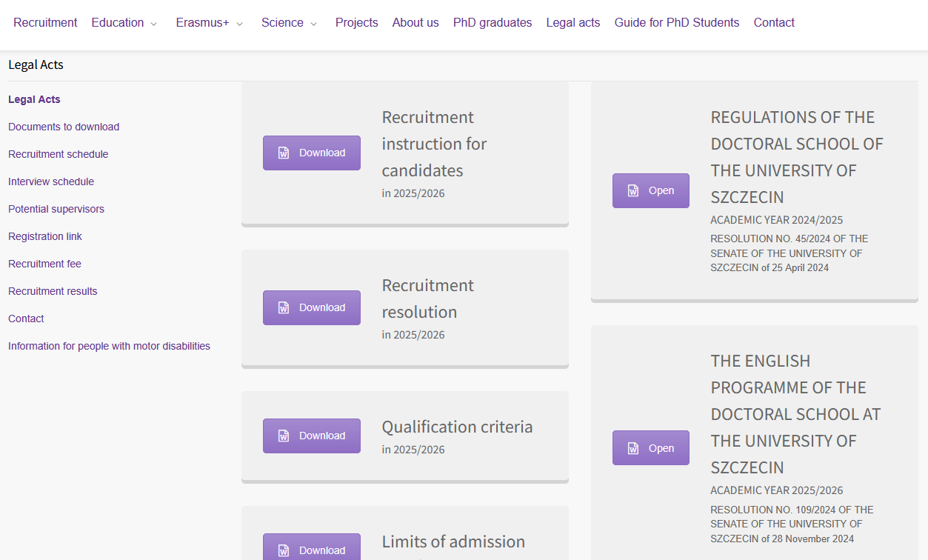
https://szkoladoktorska.usz.edu.pl/en

Slide 26



https://szkoladoktorska.usz.edu.pl/en

Slide 27
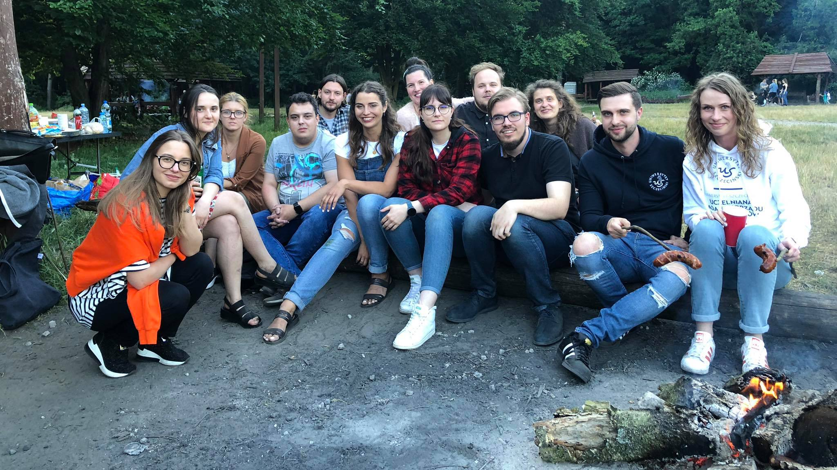


Interdisciplinary Scientific Circle of the Doctoral School at the University of Szczecin
Contact for international students:
Sebastian Matysik
Mateusz Słomiany

Slide 28
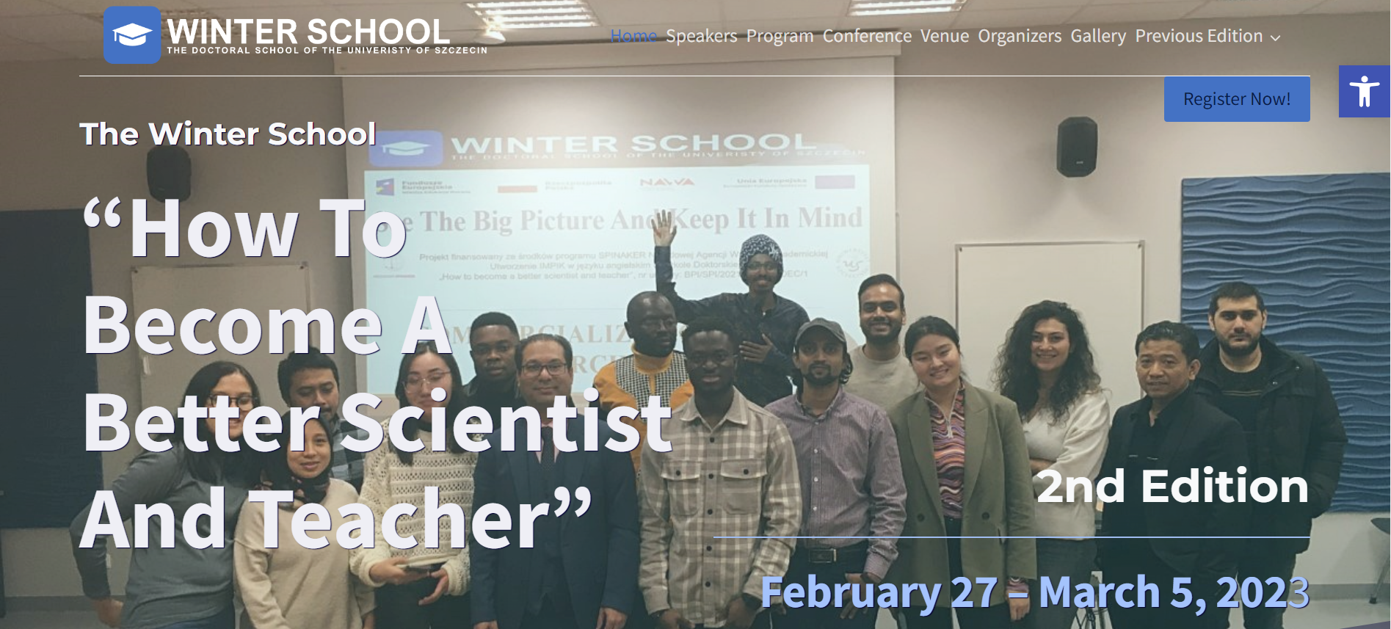
https://phdschool.usz.edu.pl
https://phdschool.usz.edu.pl

Slide 29




5 editions of International Multidisciplinary Conference of Doctoral Students of the University of Szczecin “MKDUS 2.0”

Slide 30
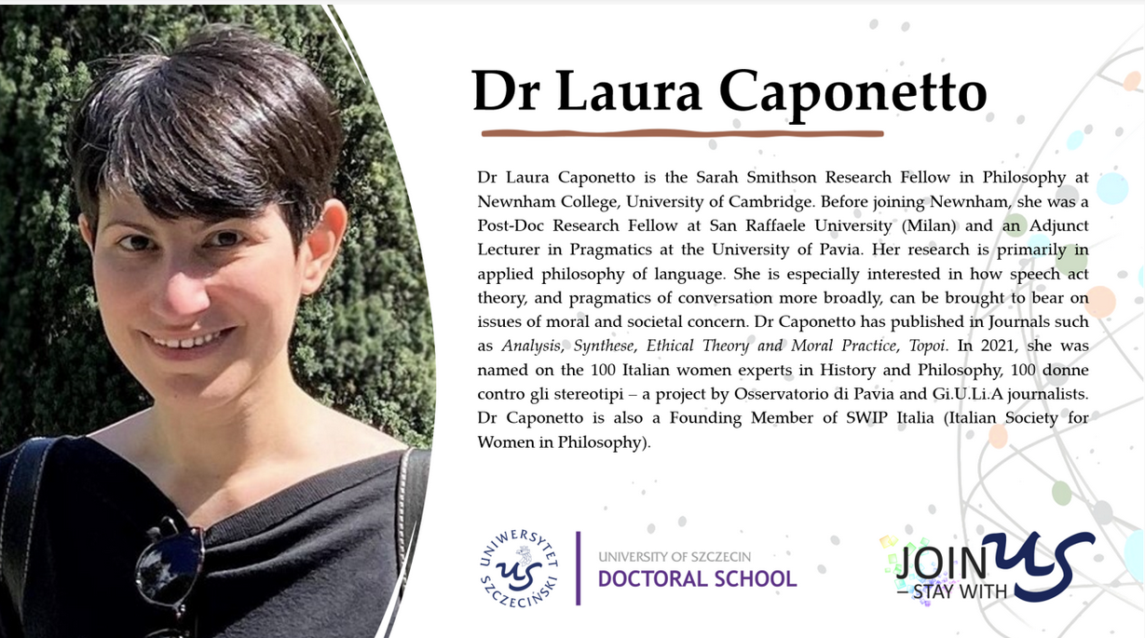
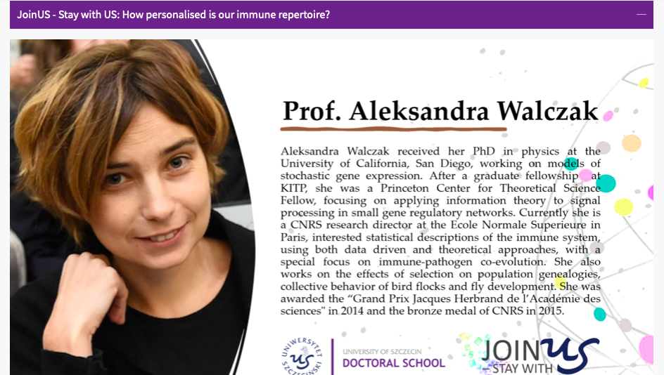


Join Us – Stay with US

Slide 31
Thank you for your attention
Contact:
al. Mickiewicza 18 70-383 Szczecin
tel. 91 444 24 77
doctoral.school@usz.edu.pl

